Slide 1
Disease Modeling Prototype
Team Name: Miracle

Slide 2
Objectives
Estimate peak and spread of the pandemic .
To enable early preparation.
To assist in decision making.
To minimize fatality and economic loss.

Slide 3
How the prototype works?
Early Stages Data
Prototype Analyze Collected Data and Generate Reports
Inform Users

Slide 4
How the prototype works
The model considered
Immigration and Emigration Movement
Population has no immune to the new disease
The disease spread via human contact only

Slide 5
How the prototype works
The prototype will analyze population density data given by NASA.
Analyzed results regarding the disease will be shown on the webpage: These results are as follow
Time to reach the infected population peak
Number of infected population (Peak)
The Distribution of the infected population (Number of infected population vs time)

Slide 6
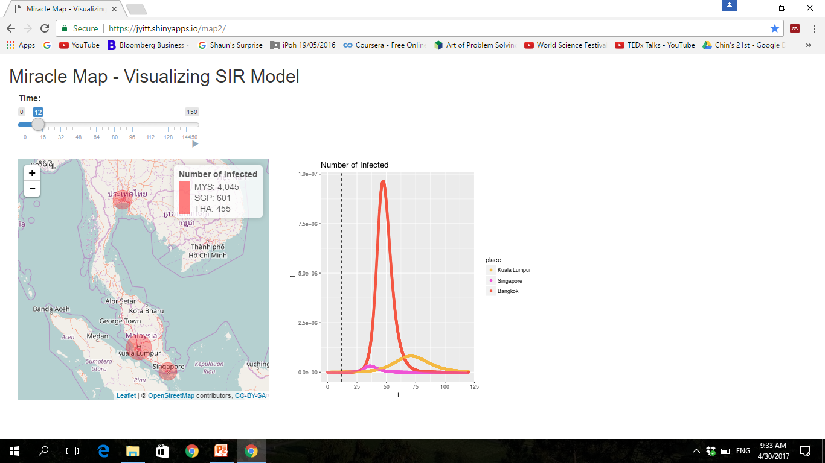
Disease Modeling : Webpage
Webpage Interface

Slide 7
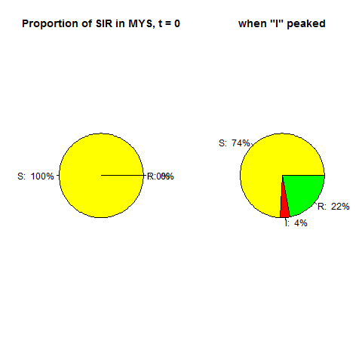
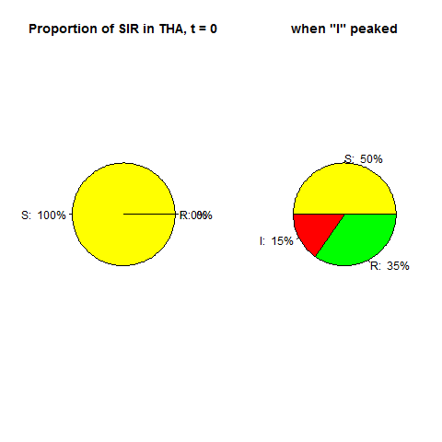

Sample Report of Disease Modeling
Changes of the demographic
Singapore
Malaysia
Thailand
S - Susceptible I - Infected
R- Recovery

Slide 8
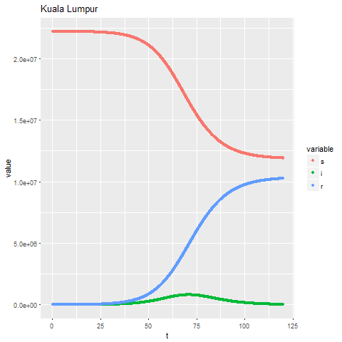
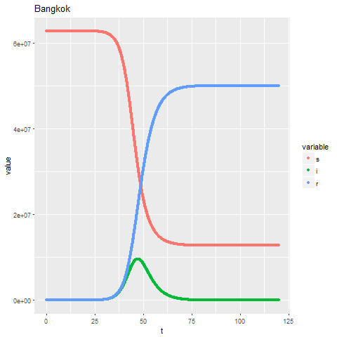
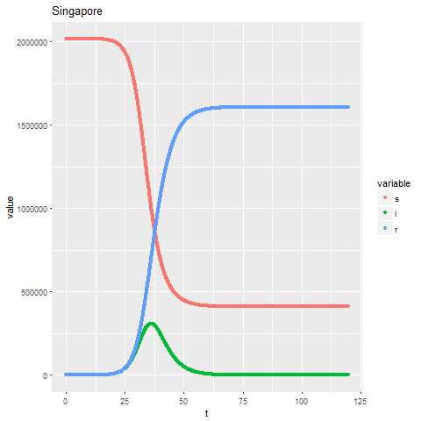
Sample Report of Disease Modeling
Changes of SIR across time
Malaysia
Thailand
Singapore
S - Susceptible I - Infected
R- Recovery

Slide 9
Aim of the Disease Modeling
This prototype will aid for:
Medical Purposes
Timeframe and amount of vaccine and medicine needed to be produce (To cure/control/prolong the time outbreak reach it’s peak period)
For Hospital to prepare for quarantine
(b) Government
Pandemic Surveillance Program
(c) Public
Understand the possibility of Outbreak
Inform public the possibility that an Outbreak will occur at a specific country (Reduce Travelling and Precaution steps)

Slide 10
Thank You!
☺

